Slide 1

XAI-Workshop
24.06.2022
Mahmoud Draz and Sophia Elsholz

Slide 2
Plan for today
1
Introduction to XAI
2
Introducing and implementing different XAI-methods
Permutation Importance
Class Activation Maps (CAM) and Gradient weighted-CAM
LIME
SHAP
Partial dependence plot
Global Surrogate
Information Bottleneck Theory
3
Feedback and Outlook

Slide 3
1
Introduction to Explainable Artificial Intelligence

Slide 4
1. Introduction to XAI
"XAI will create a suite of machine learning techniques that enables human users to understand, appropriately trust, and effectively manage the emerging generation of artificially intelligent partners“ [1]x
XAI
Deep Learning
Machine Learning
Artificial Intelligence

Slide 5
1. Introduction to XAI
Purposes
Verification of the system
Improvement of the system
Learning from the system
Compliance to legislation
Are the features the model categorizes as important really important?
Based on the results, is our model good enough or can we improve it?
Can we use the model to imporve in real live behaviour?
Is the model‘s output compatible with the the current legal situation?

Slide 6
1. Introduction to XAI
Classification Methods for XAI
Scope of the explaination
Global Explainations
Local Explainations
Universality of the system
Model Specific
Model Agnostic
Insight into the model
Interpretable model
Post-hoc Explainability
Methods try to explain the system as a whole.
Methods are compatible with every model.
Model is a whitebox
Methods can only explain the decision of one instance at once.
Methods can only deal with specific models and might be adjusted.
Model is a blackbox

Slide 7
1. Introduction to XAI
Classification Methods for XAI
Scope of the explaination
Global Explainations
Local Explainations
Universality of the system
Model Specific
Model Agnostic
Insight into the model
Interpretable model
Post-hoc Explainability
Methods try to explain the system as a whole.
Methods are compatible with every model.
Model is a whitebox
Methods can only explain the decision of one instance at once.
Methods can only deal with specific models and might be adjusted.
Model is a blackbox

Slide 8
1. Introduction to XAI
Classification Methods for XAI
Scope of the explaination
Global Explainations
Local Explainations
Universality of the system
Model Specific
Model Agnostic
Insight into the model
Interpretable model
Post-hoc Explainability
Methods try to explain the system as a whole.
Methods are compatible with every model.
Model is a whitebox
Methods can only explain the decision of one instance at once.
Methods can only deal with specific models and might be adjusted.
Model is a blackbox

Slide 9
2
Introducing and implementing different XAI-methods

Slide 10



Used AI-Methods and datasets
Dataset 1 - Stroke
Dataset 2 – Cats and dogs
5,110 datapoints
Tabular data
25,002 datapoints
Image data
https://www.kaggle.com/datasets/fedesoriano/
stroke-prediction-dataset
https://www.tensorflow.org/datasets/catalog/cats_vs_dogs

Slide 11
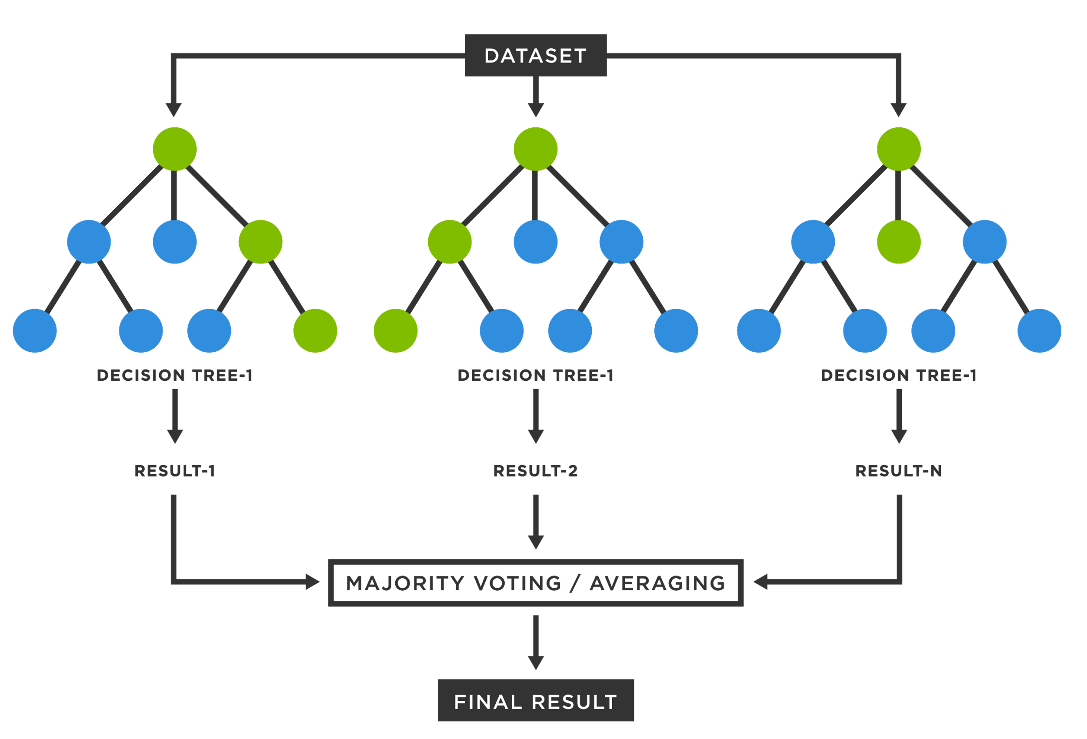
Used AI-Methods and datasets
AI Method 1 – Random Forest
AI Method 2 – Neural network
System of neurons and connections that is inspired by the human brain
Several decision trees that are combined

Slide 12
2.1 Permutation Importance
Global Explainations
Model Agnostic
Post-hoc Explainability
Main idea
Shuffle the value of one feature column
Then check the performance of a pretrained network on this permuted dataset
The importance of a feature can then be determined by the performance change of the network
Further information can be found on https://arxiv.org/pdf/1801.01489.pdf
Id | Feature 1 | Feature 2 | Feature 3 | Feature 4
1
2
3
…
Idea: Shuffle one column and compare the performances

Slide 13
2.1 Permutation Importance
Global Explainations
Model Agnostic
Post-hoc Explainability
Algorithm
Take a model that was fit to the training set
Estimate the predicted performance of the model on a validation dataset and take that as the baseline performance
For each feature j:
Shuffle all the values of the column in the original dataset (the other columns and labels are fixed)
Record the performance of the shuffeled dataset on the original network
Compute the feature importance as the absolute difference between the baseline performance and the performance of the shuffeled dataset.
Repeat a - c for a large number of times and average over all trials.

Slide 14
2.2 Class Activation Maps (CAM) and Gradient weighted-CAM
Global Explainations
Model Agnostic
Post-hoc Explainability

Slide 15
2.3 LIME
Local Explainations
Model Agnostic
Post-hoc Explainability
Main idea
A computed decision function by a model often is complex and nonlinear
LIME doesn’t look at the whole decision function but selects a single datapoint
For this datapoint it tries to fit a linear model that can explain
For that point we try to find a linear model that can explain the points in the neighbourhood as well
Further information can be found on https://arxiv.org/pdf/1602.04938.pdf

Slide 16
2.3 LIME
Local Explainations
Model Agnostic
Post-hoc Explainability
Point of class 1
Point of class 2
Step 1 We have a model with a nonlinear
decision function
Step 2 We decide on one data point we want to inspect further

Slide 17
2.3 LIME
Local Explainations
Model Agnostic
Post-hoc Explainability
Point of class 1
Point of class 2
Step 3 Sampling around this datapoint. For every new datapoint we can compute the distance by a similarity kernel.
Step 4 With the new points we can do regression to find a local fitting decision function.

Slide 18
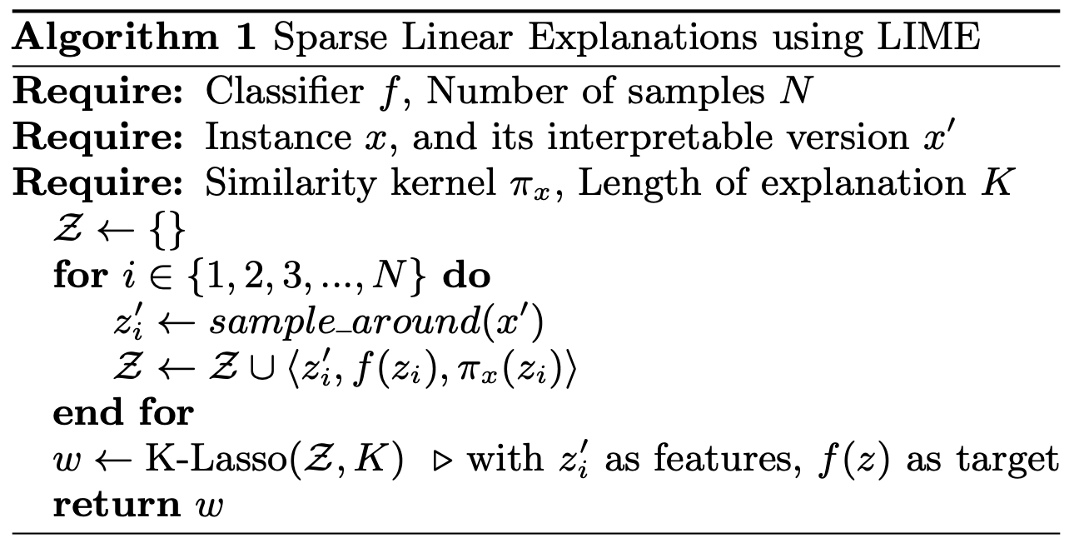
2.3 LIME
Local Explainations
Model Agnostic
Post-hoc Explainability
For every sample i, draw samples in the neighborhood
Add the sample, the predicted label and similarity to Z
K-lasso is a regression method

Slide 19
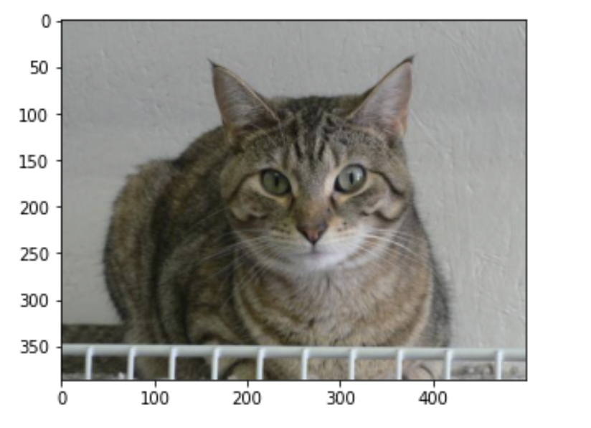
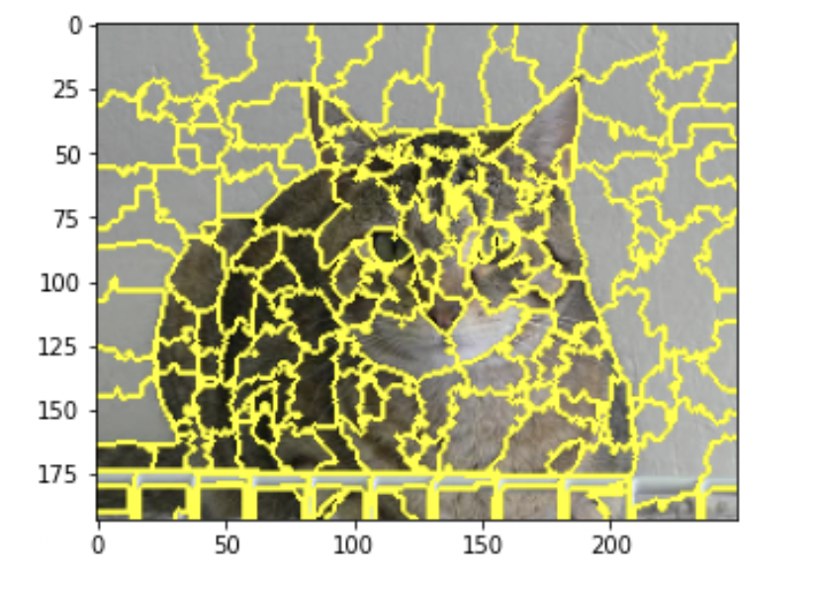
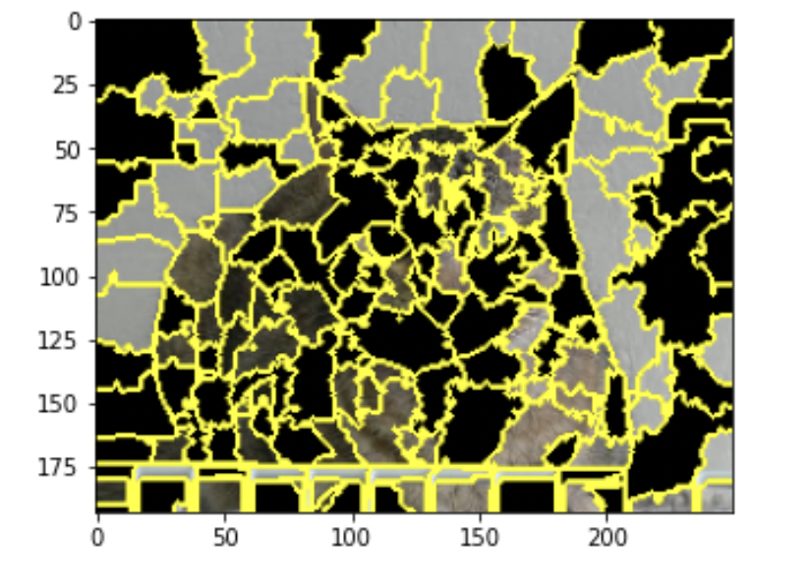
2.3 LIME with Images
Local Explainations
Model Agnostic
Post-hoc Explainability
Fig. 2 We can split the image into superpixels that are randomly turned on and off

Slide 20
2.4 SHAP
Local Explainations
Model Agnostic
Post-hoc Explainability
Main idea
xxx
Further information can be found on https://arxiv.org/pdf/1602.04938.pdf

Slide 21
2.5 Partial dependence plot
Local Explainations
Model Agnostic
Post-hoc Explainability
Main idea
xxx
Further information can be found on https://arxiv.org/pdf/1602.04938.pdf

Slide 22
2.6 Global Surrogate
Local Explainations
Model Agnostic
Post-hoc Explainability
Main idea
xxx
Further information can be found on https://arxiv.org/pdf/1602.04938.pdf

Slide 23
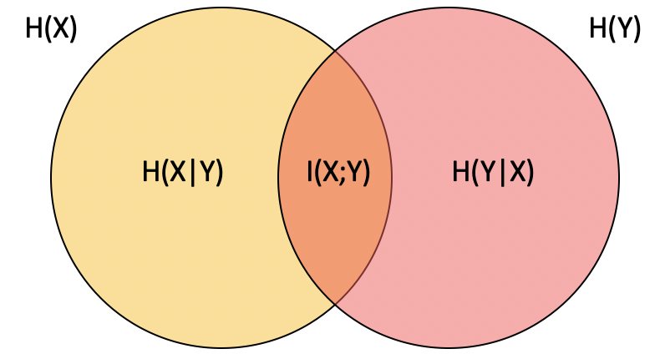
2.7 Information Bottleneck Theory
Global Explainations
Model Specific
Interpretable model
Mutual Information
It is possible to estimate how much information from one layer of a NN is carried to another by using the concept of Mutual Information (MI)
The MI describes the statistical correlation between two random variables (in our case the neurons)
The development of MI during training helps to understand the process of learning during the epochs
Further information can be found on https://arxiv.org/pdf/1602.04938.pdf
Fig. 3 The orange part describes the
Mutual Information

Slide 24
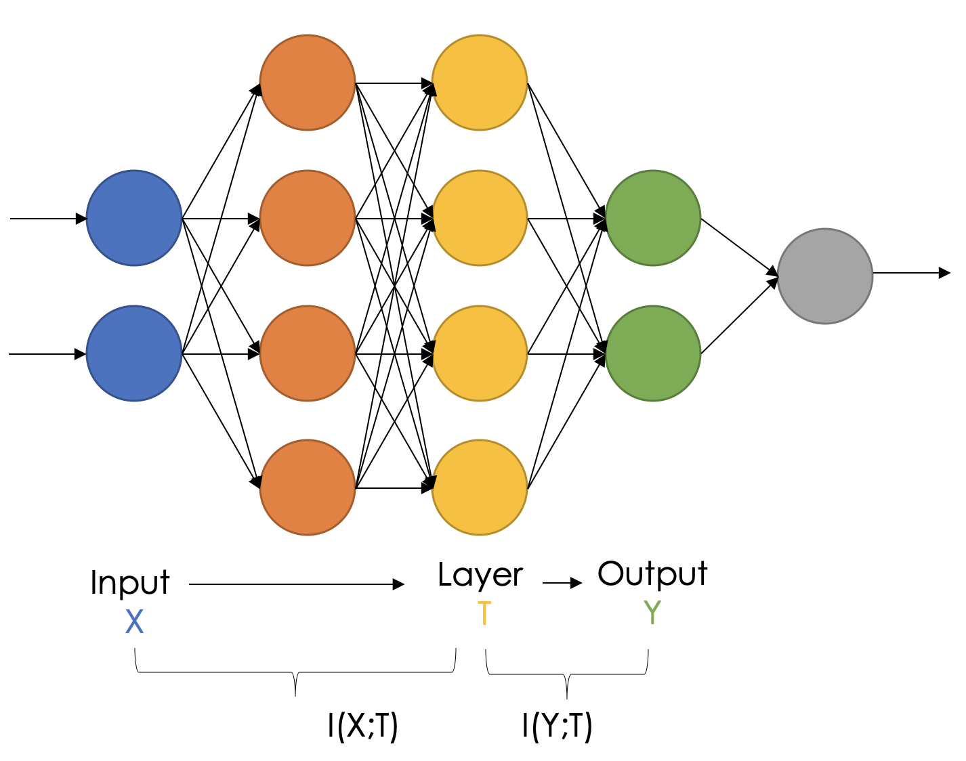
2.7 Information Bottleneck Theory
Global Explainations
Model Specific
Interpretable model
Measuring the MI
I(X;T) is the MI between the input X and a layer T
I(Y;T) is the MI between the layer T and the output y
Estimation Methods
There are several methods to estimate the MI such as
Upper and lower bound
Binning (summarize several neuron‘s output in one bin)
MINE

Slide 25
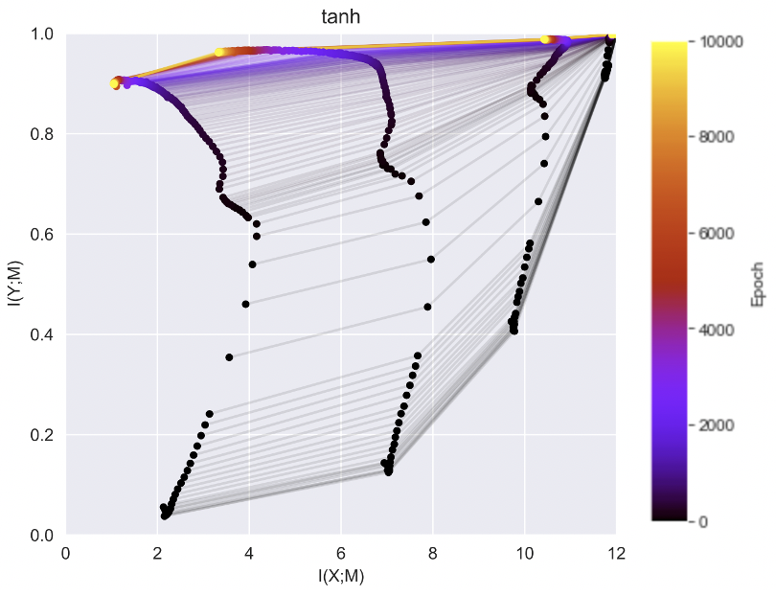
2.7 Information Bottleneck Theory
Global Explainations
Model Specific
Interpretable model
Mutual Information plots
Activation function
Compression phase
The higher the epoch the lighter the color
Every line stands for one layer

Slide 26
3
Feedback and Outlook

Slide 27
Sources
[1] GUNNING, D.; AHA, D.: DARPA’s explainable artificial intelligence (XAI) program. AI Magazine. 2019, vol. 40, no. 2, pp. 44–58.
[2] https://www.kdnuggets.com/2019/12/interpretability-part-3-lime-shap.html

